Slide 1
Video Analytics
- Techlead Software Engineering Pvt. Ltd.

Slide 2
Why Video Analytics?
The increasing rate of crime calls for effective security measures.
Security Personnel, IP Cameras, CCTV are usually employed for these reasons.
But Human vigilance is required in each case which is bound to induce errors.

Slide 3
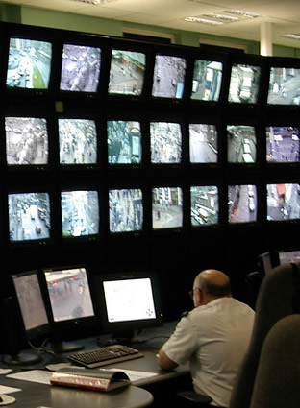
Why Video Analytics?
Manually monitoring CCTV cameras is tedious and monotonous which effectively reduces productivity.
Automated surveillance and analytics avoid these errors caused due to boredom and limited concentration span of humans.
Video Surveillance and Analytics has gained popularity as automated solutions are efficient.

Slide 4
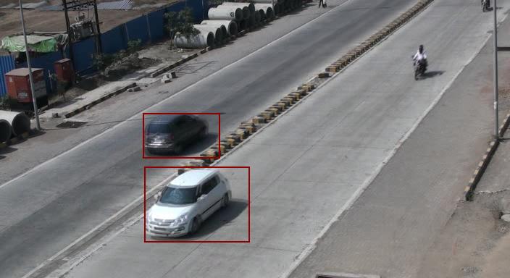
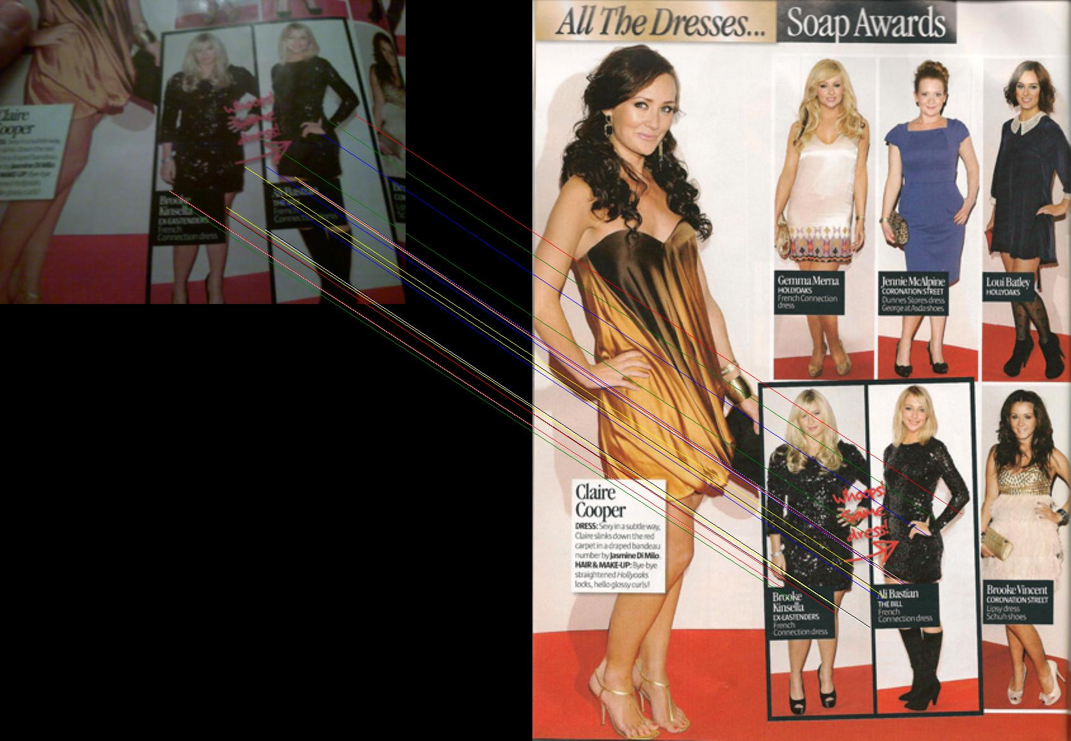
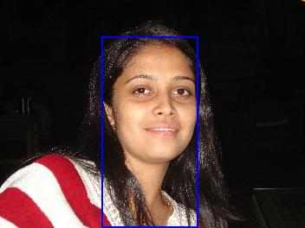
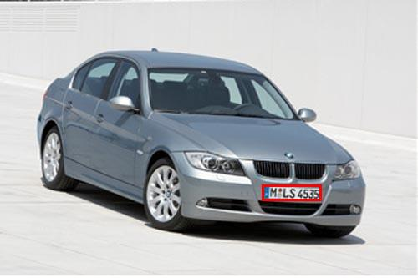
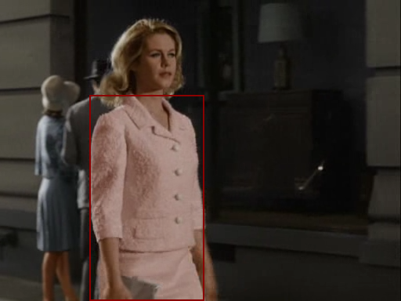
Solution by Techlead
Face Detection
License Plate Detection
Color Based Object Tracking
Restricted Zone Intrusion
Object Recognition

Slide 5
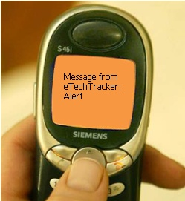
Solution by Techlead
Configurable Alert System
SMS
Email
Hooter

Slide 6
Feature Applications
Face Detection
People Counting
Crowd Management
People Loitering
Object Recognition
Abandoned Object Detection
Missing Object Detection
Color Based Object Detection
Directional Movement

Slide 7
Features Application
Restricted Zone
Intrusion Detection
Geo-Fence Control
Parking and Traffic Management
Traffic violation and Tracking
Stop Light Violation
One way traffic control
License Plate Detection
Camera Tampering / Blinding

Slide 8
Features Application
Customizable user-friendly interface. User can set object parameters like
Minimum and maximum size
Color of Object
Location of Object
Template Image
Area of Interest (Restricted Zone)
Increased Efficiency
Operator
Entire system

Slide 9
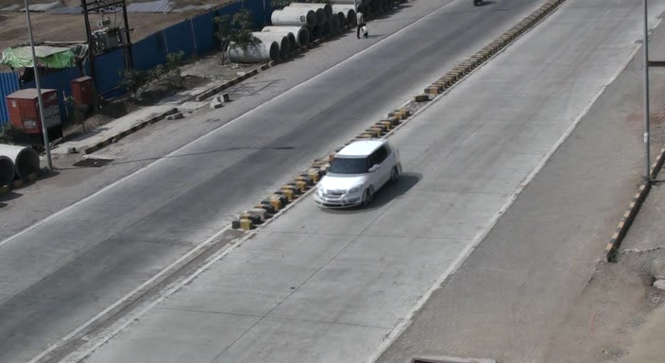
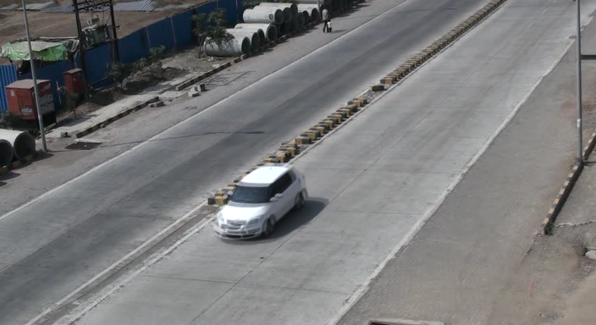
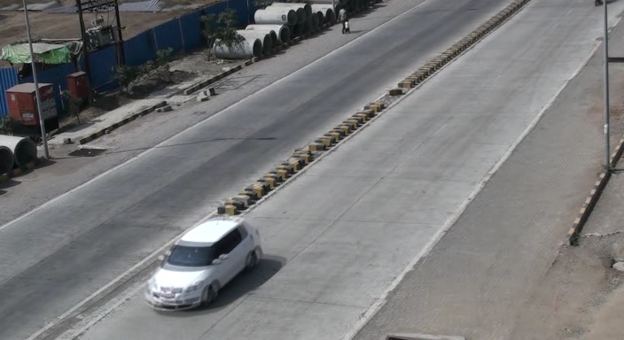
How it Works?
Play Video on Click
Frame 1
Frame 2
Frame 3

Slide 10
How it Works?
Frame 1
Frame 2
Frame 3
SMS
Video Analytics
Software
Alerts Engine
Email
Hooter
Alerts Notification

Slide 11
Face Detection
Detects only Human Faces and Filters out all the other information content from the Image
For Intrusion detection- Instead of watching hours of long videos, searchers can just scan through a few frames (where faces are detected). This will save lot of time.
Face is detected through extraction of biological features
Results – as follows

Slide 12
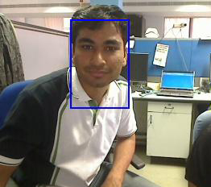
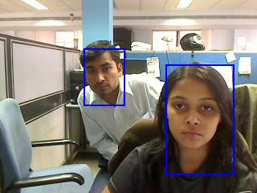
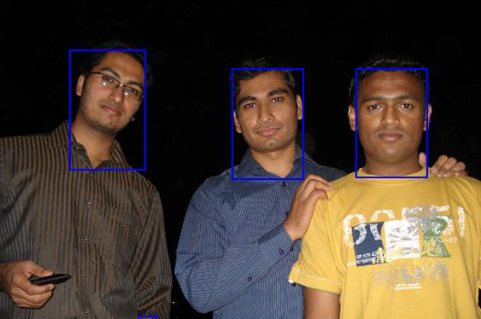
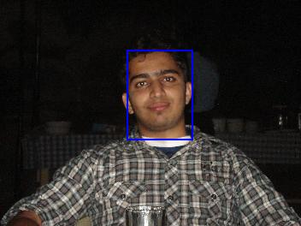
Face Detection
Faces detected are marked with blue rectangles

Slide 13
License Plate Detection
This feature of video analytics extracts the License plate region from any image.
Applications
Toll Plaza
City Surveillance Cameras
Almost all Security applications
Results - The following slides show license plates detected marked with a red rectangle.

Slide 14
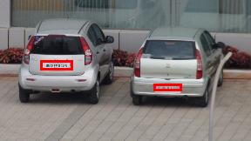
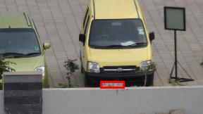
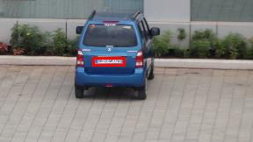
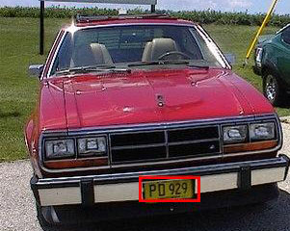
License Plate Detection

Slide 15
Object Recognition and Tracking Applications
Object Tracking in video surveillance:
The intelligence in video surveillance can be achieved by automating the tasks of humans. By making the software keep a track on particular specified object (Car, human etc) this can be achieved.
Detecting Missing Object in an video frame:
Same way as above, here the aim is to identify a situation where an object which was present at a given location is suddenly missing from its position.
Pattern Recognition :
Object of an particular shape or size or of a example template is matched with the live video or captured frames form any camera. E.g. detection of a company lable in a video / images of variety of products.

Slide 16
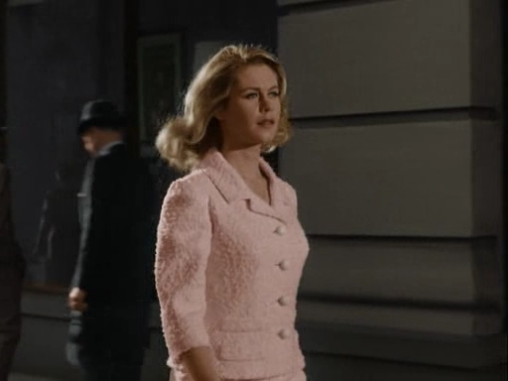
Color Based Object Tracking
This tool can identify an object of a specified set of parameters from the video.
User has to select the object of interest from a single reference frame of the video.
Play Video on Click
Reference frame selected for parameter settings

Slide 17
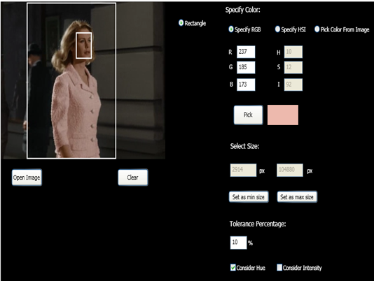
Color based Object Tracking Settings
Minimum Size
of Object
Color of Object to be
Located:
R, G, B
H, S, I
Pick color from Image
Pick color from color
palette
Maximum Size
of Object
Reference Image

Slide 18
Color Based Object Tracking
All the selected objects are identified in each frame.
Each object is matched with the specifications of the object of interest.
All objects matching those specifications are shortlisted and tagged for further perusal of the user.

Slide 19
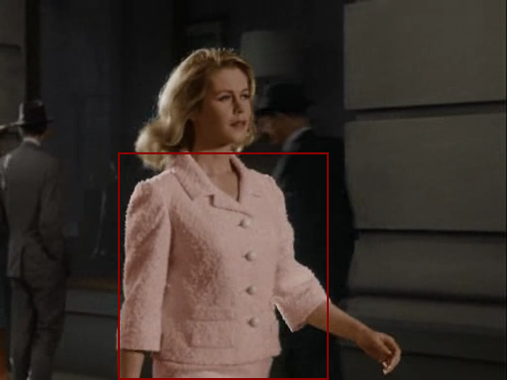
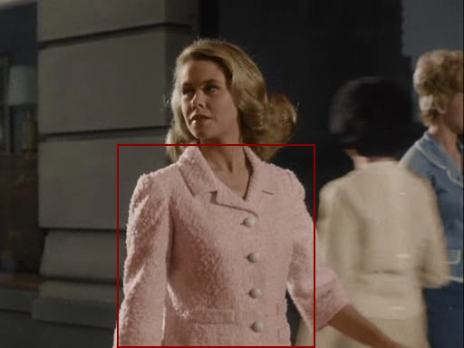
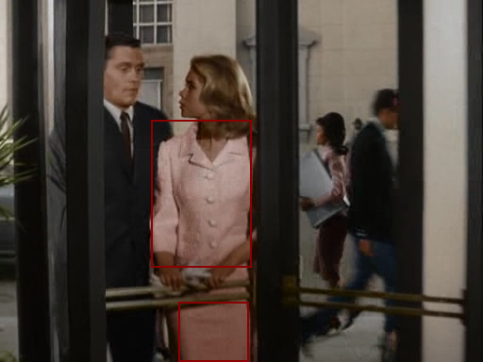
Color Based Object Tracking
Objects identified are marked in Red

Slide 20
Missing Object
This is an application to avoid theft of stationary objects like a bag placed somewhere and marked to be guarded or some other object like public telephone.
The Object of Interest can be marked by the authorities.
A video continuously monitoring this object of interest is processed and analyzed for thefts.

Slide 21
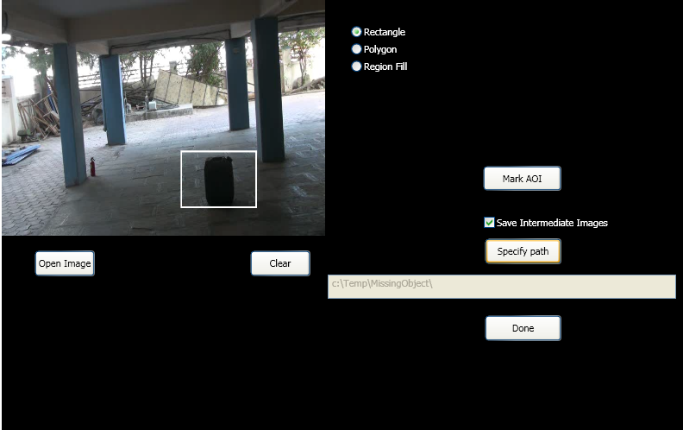
Missing Object Settings
Reference Image
Object of Interest

Slide 22
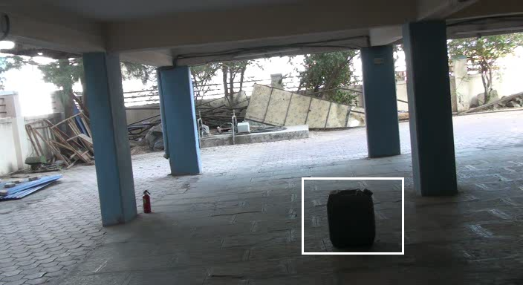
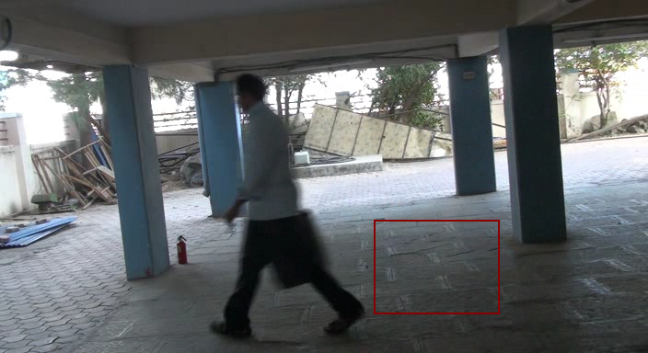
Missing Object
Object Of Interest Marked by User
Object Missing (identified after a few frames in the video)

Slide 23
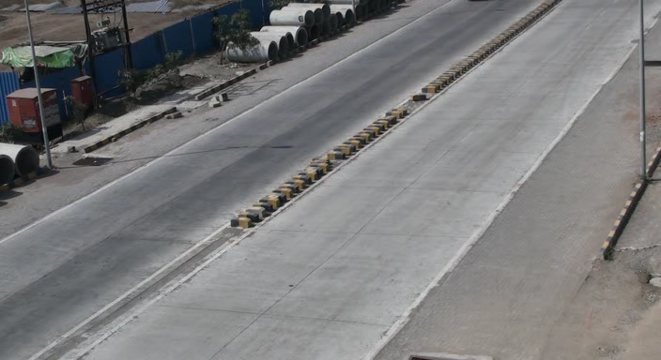
Restricted Zone
This allows user to specify a Restricted Zone from a reference image.
Any object trespassing this area will generate an alarm and will alert the authorities.
Play Video on Click
Reference image of the video

Slide 24
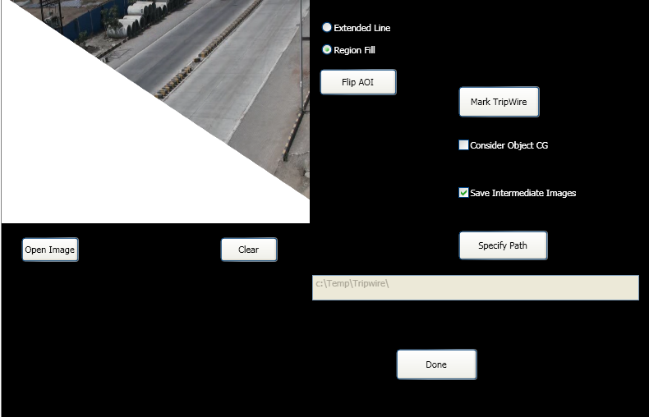
Restricted Zone Settings (We should use some logical image here)
Reference Image
Restricted Zone marked in White

Slide 25
Restricted Zone
Invasion of Privacy and violation of No-Parking Zones etc. can be detected.
All Objects in the frame are identified.
Any object seen in the restricted zone triggers an alarm.
The authorities are notified of the details of the object in any mode convenient to them (SMS, Email or Alarm).

Slide 26
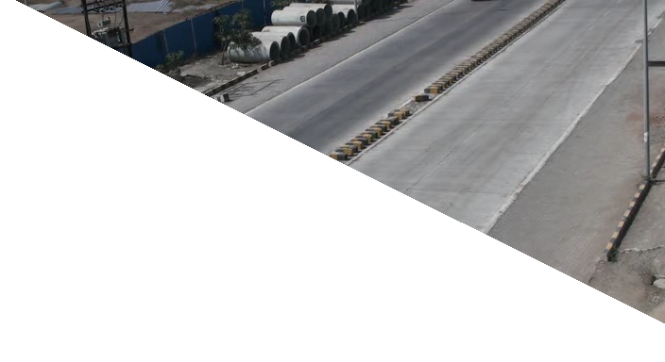
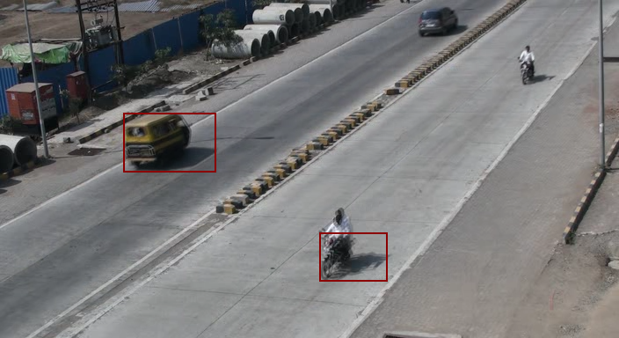
Restricted Zone
Fig. a. Original Image
Fig. b. White Area indicates Restricted Zone
Fig. c. Objects appearing in Restricted Zone are Marked
Fig. d. Objects appearing in Restricted
Zone are Marked

Slide 27
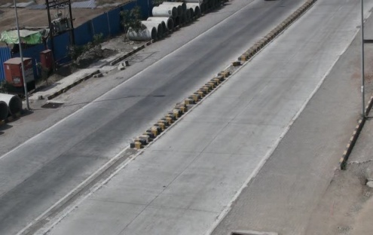
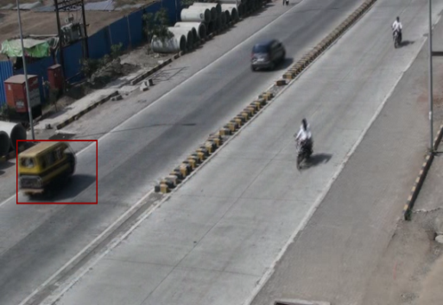
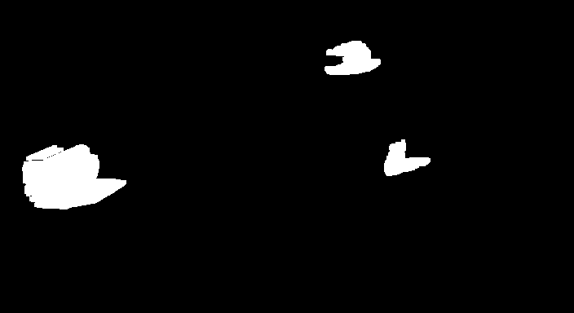
Object Isolation
Base Image
Image with Objects
Object Isolation
(with shadows)

Slide 28
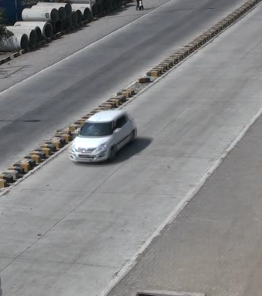
Smart Feature Extraction
Intelligent Feature extracted (Prominent colour is extracted while the shadow like low information regions are removed)

Slide 29
Feature Based Object Recognition
Main AIM – Detect a given feature (image template) in the given input image/ video.
Detection should be independent of size of the feature in template image and input image/video
Detection should be independent of the illumination conditions in the two images
Object Matching is done on the basis of intelligent extraction of features.
(Results ….)

Slide 30
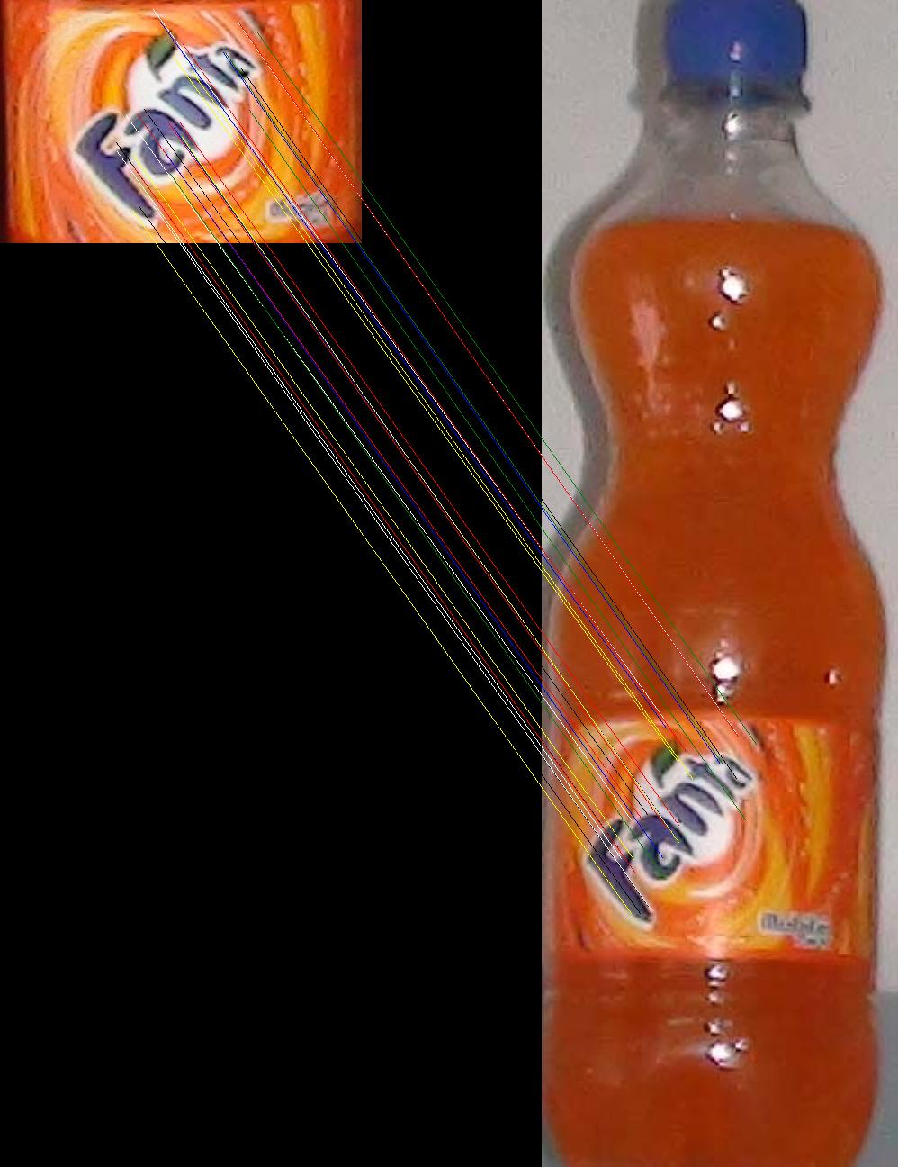
Match This template image in the actual Image
i.e. locate the Fanta Logo in the entire input Image.
Template Image
Matching
The colored lines
drawn across the
images show the
Corresponding feature
Points
Entire Fanta Bottle as Input Image

Slide 31
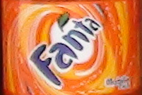
The right side image shows the
position where the left side
template image matches it
marked with a blue rectangle

Slide 32
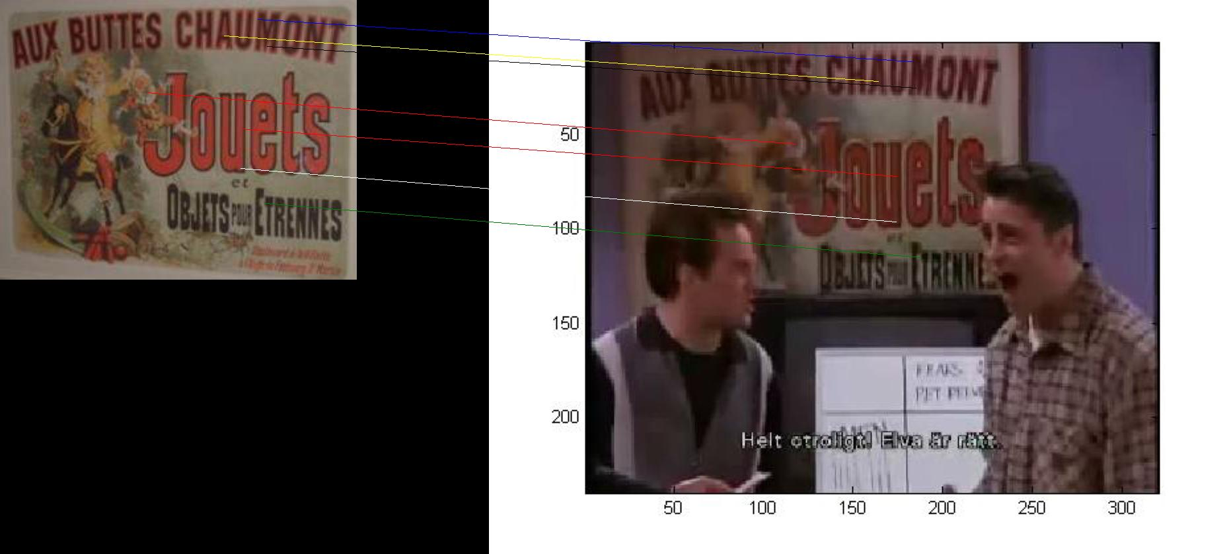
E.g. 2
The colored lines
drawn across the
images join the
feature points
which match

Slide 33
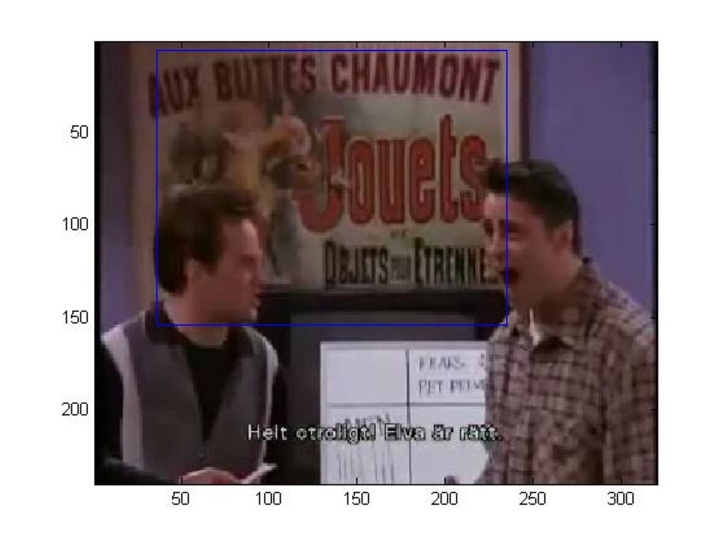
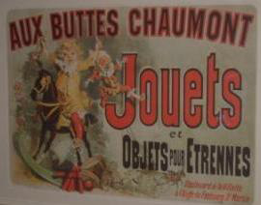
The right side image shows the position where the left side template image matches it marked with a blue rectangle

Slide 34
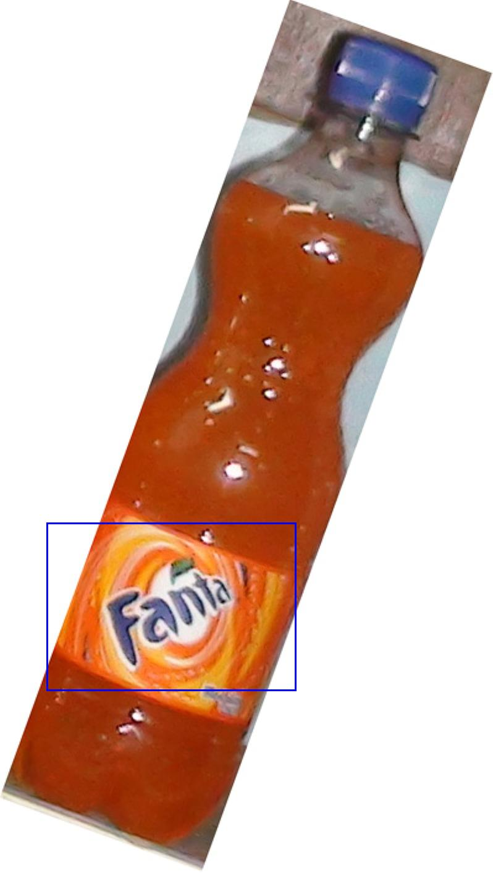
Rotated Bottle
Detection

